Slide 1
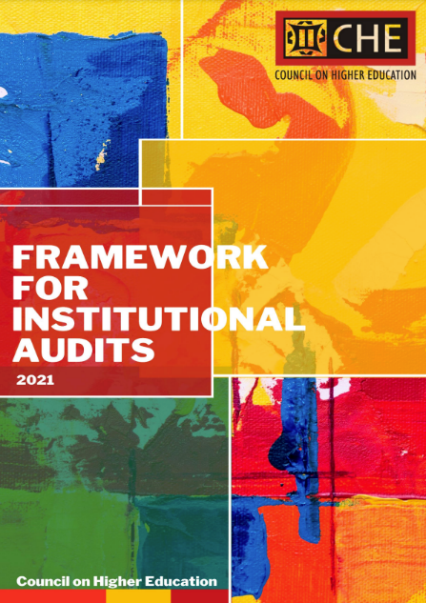
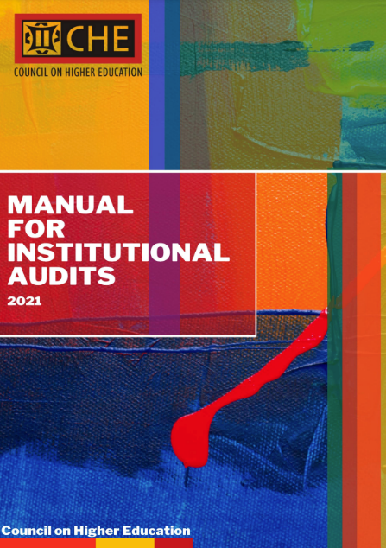
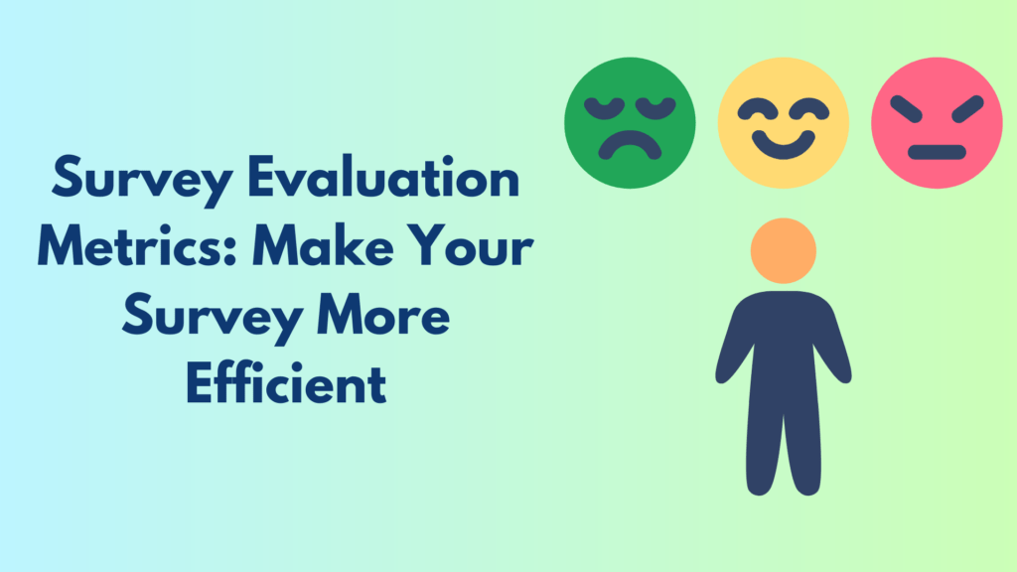
A Review Methodology Towards Institutional Audits in South Africa
Council on Higher Education (CHE)
The Council on Higher Education (CHE) as the external quality assurance agency in South Africa was legislated into being by the Higher Education Act (101 of 1997, as amended. The quality assurance and promotion mandate of the CHE, which it performs through the Higher Education Quality Committee (HEQC), includes “audit[ing] the quality assurance mechanism of higher education institutions”. The CHE is currently conducting the second cycle of institutional audits. The current Framework for Institutional Audits 2021 (CHE, 2021a), and the Manual for Institutional Audits 2021 (CHE, 2021b) were developed to incorporate and reflect lessons that would make the current cycle of audits more meaningful and beneficial for institutions and the sector at large.
The institutional audits are based on an evidence-based review methodology, consisting of both self-reflection and peer review. The institutional audits are based on four (4) Focus Areas, and sixteen (16) Standards and Guidelines which are informed by a specific set of principles. These include, amongst others, institutional responsibility of internal quality assurance, differentiation amongst institutions, and a balance between regulatory accountability and a developmental approach.
https://www.che.ac.za/publications/frameworks/framework-institutional-audits-2021
https://www.che.ac.za/publications/frameworks/manual-institutional-audits-2021
Abstract
This poster is based on two analytical tools; the evaluation surveys targeting individual institutional participants to reflect on the institutional audits process, and the discourse analysis based on the self-evaluation reports submitted by institutions and the draft audit reports produced by the audit panels.
The purpose of the surveys was to get insight into the value and/or meaningfulness of the institutional audits, including the effectiveness and efficiency of the CHE’s processes. The survey reports on the experiences of individual institutional participants across 19 universities who had completed the institutional audit site visit process between April and November 2022. The discourse analysis was conducted on the self-evaluation reports and draft audit reports for the 19 institutions that have participated in the institutional audit process focusing on emergent themes in South African public universities gleaned through document analysis of the institutional self-evaluation reports and draft audit reports. It presents discourses from career development trajectories of women academics in public universities in South Africa. Noticeably, there is still a paucity of women representation at professoriate levels. Correspondingly, creating pathways from lecturer to senior lecturer, and from senior lecturer to the professoriate, seems a tough assignment to accomplish for women academics owing to, inter alia, work-life balance issues. Thus, establishing and retaining a pool of competent staff at senior lecturer to Professor level will require intentionality and institutional cultures that support this expected growth.
The critical analysis is of the nexus between staff wellness, workload, and workload models in public universities. Across the globe, the COVID-19 pandemic placed unprecedented and significant stress on academic staff within higher education. To save the academic year and ensure student success, staff across South African higher education have had to introduce and adapt to new, technology-driven teaching and learning approaches within a constrained national socio-economic environment. This is in addition to the high demands for increased research publications, excellence in teaching, community engagement and effective academic citizenship. Through the framework of Ethics of Care, the study analyses the correlation between workload, workload models and staff wellness as reflected in the institutional Self-Evaluation Reports. Preliminary results indicate minimal critical reflections on staff wellness and well-being, with much focus being on the impact of COVID-19 on the academic enterprise. Workloads and workload models are generally discussed in relation to performance management, productivity, research outputs and professional development, as opposed to staff wellness. We conclude by recommending further research, using the audit reports to triangulate the results to understand, through the Ethics of Care lens, the extent to which universities focus on staff wellness as part of quality management.
Based on the preliminary reflections and findings, the researchers argue for a sector-wide critical discourse on the impact of workload and workload models considering the significance of staff wellness in ensuring student success. It further advocates for intentionality on the part of institutions to develop enabling structures and cultivate cultures that support effective career development of women academics. However, these findings can be validated through future research.
Evaluation Survey
Discourse analysis
of Institutional Self Evaluation Report and Draft audit reports
Evaluation Survey and discourse analysis as analytic tools for reflection
1
2
Evaluation Survey
Discourse analysis on emerging themes
COHERENCE OF THE FOCUS AREAS, STANDARDS AND
GUIDELINES FOR THE AUDIT
CAREER DEVELOPMENT TRAJECTORIES OF WOMEN ACADEMICS IN PUBLIC UNIVERSITIES IN SOUTH AFRICA
Using critical discourse analysis, underpinned by social realist lenses, grounded on Archer (1996)’ s social realist perspective; four sets of overarching discourses were identified: (1) work-life balance; (2) institutional cultures; (3) professional development goals; and (4) human agency. Archer (1996) theorised that any undertaking aimed at understanding any aspect of the social world, entails examining structural, cultural, and agential conditions that are prevalent in that space. Understanding the interplay between these contradicting discourses will aid institutions towards intentionally providing enabling work environments that promote academic success. These discourses explain how women academic career development trajectories are constructed. Furthermore, they explain how institutional structures and cultures can constrain or enable women academics’ human agency for career development.
Work -life Balance
Family support structures
Balancing personal life with professiongal goals
Institutional Culture
Human Agency
Grit
Professional Development Goals
Performance Management systems
Balancing teaching workloads with other core academic functions
Career development
PhD
Publications
Research supervsion
Enabling organisational culture
Systems and poliices
Leadershp support
Determination to succeed
Looking for opportunities to succeed
intrapsychic motivation
Critical analysis of the nexus between staff wellness, workload and workload models in public universities
3
Minimal reflections on staff wellness
Correlation between workloads, workload models and productivity
More reflections on COVID-19 effects on institutions
Insufficient reflections on nexus between wellness and workload models
Need for further triangulation with audit reports
EMERGING THEMES FROM SELF-EVALUATION REPORTS ON STAFF
Emerging themes from the audit process
COMMUNICATION AND VISIBILITY
CAPACITY BUILDING OF THE SECTOR
ELEVATE AND STRENGTHEN DISCOURSE ON ROLE OF ACADEMICS AND SUPPORT STAFF IN QUALITY ASSURANCE
“CHE should engage all university stakeholders in open dialogues to make everybody that QA is the responsibility of each individual. Strengthen institutional internal quality controls. Create awareness about the needed for continuous self-reflective frameworks. Enforce institutions to do internal reviews most frequently.”
“CHE could possibly go on an awareness campaign informing HEIs about their activities, programs and role in higher education. A proper social media campaign could also assist in demystifying the role and function of CHE.”
“Ongoing capacity building workshop on quality assurance activities. The institutional audits were a very good start. It focused the attention of relevant stakeholders on the issue of quality assurance, its importance in the context of what we do, and highlighted areas that required further attention. The audit in and of itself has started a process of more serious QA engagement and highlighted the role of various stakeholders involved in the academic project in this process.”
“CHE should continuously explain to Academics & support staff the importance of QA and how it enhances the learning experience of students and improves the profile of the institution. QA should be built into the academic and administrative processes of HEI [Higher Education Institutions].”
“Conduct workshops that do not only target management and or QA officials, but also engage all the academic.”

