Slide 1


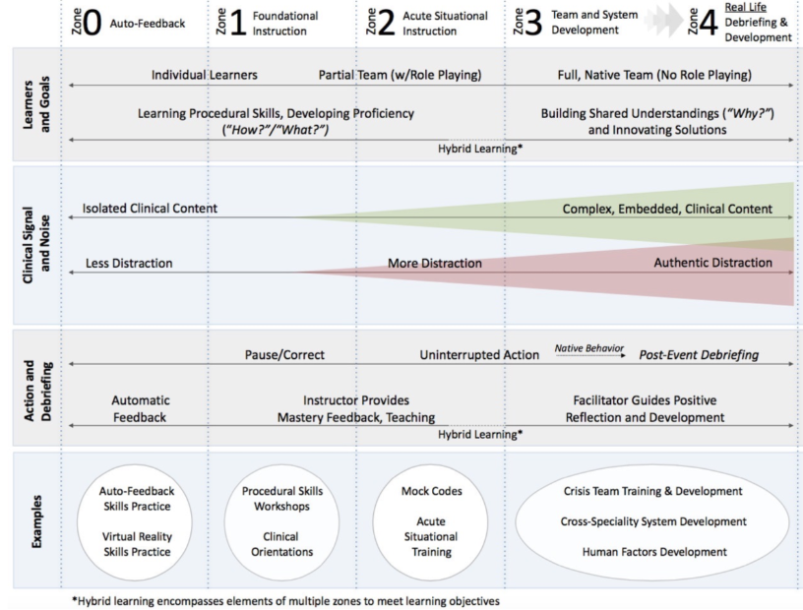
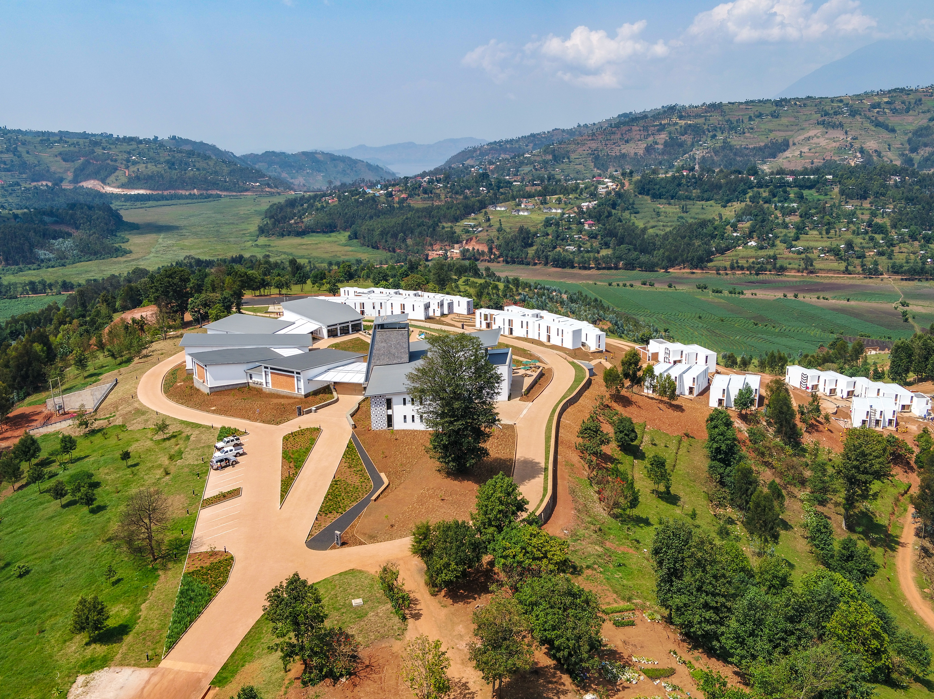
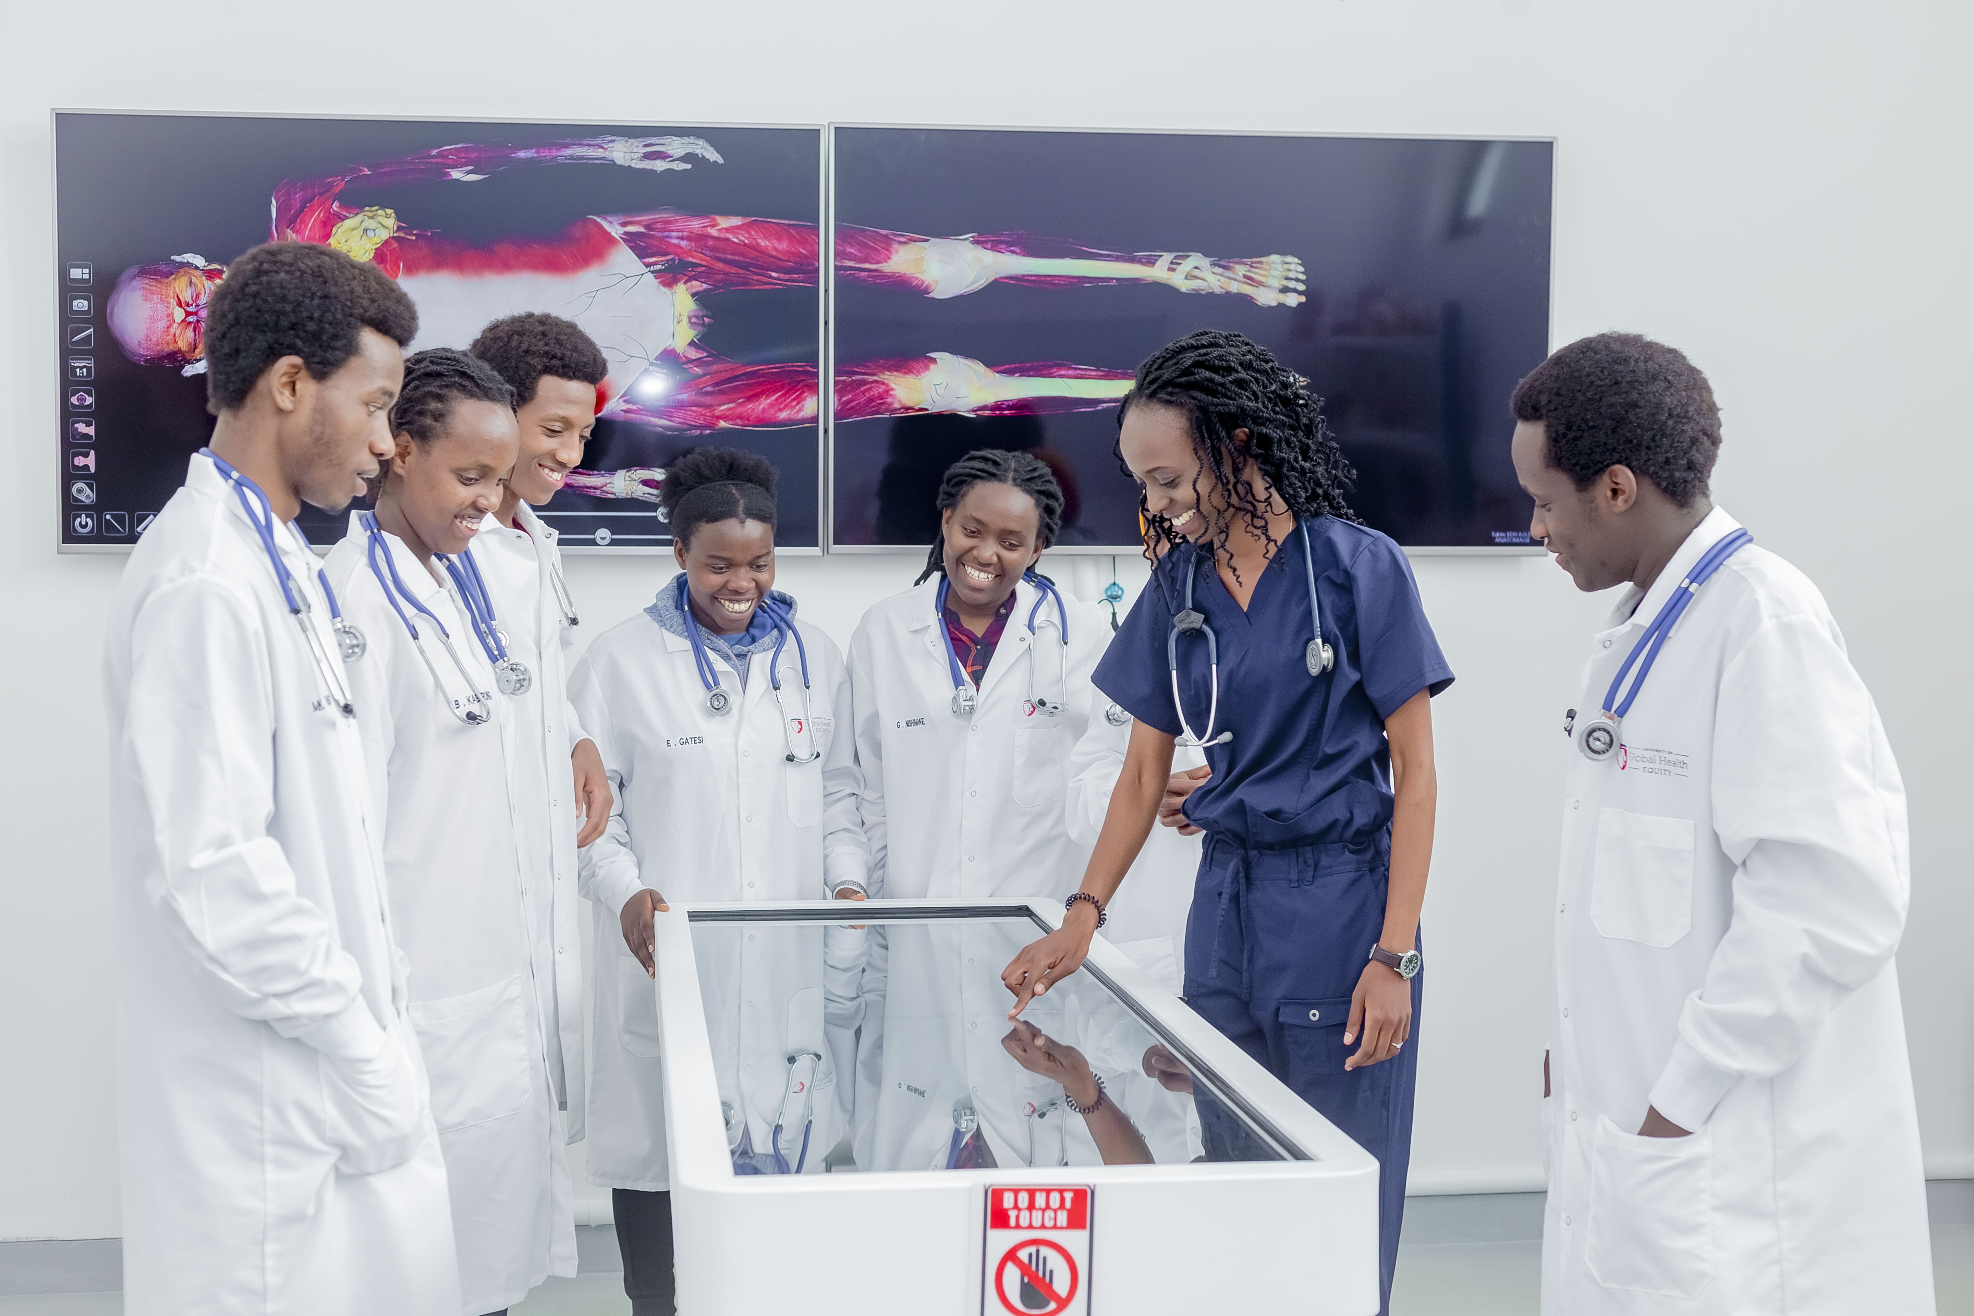
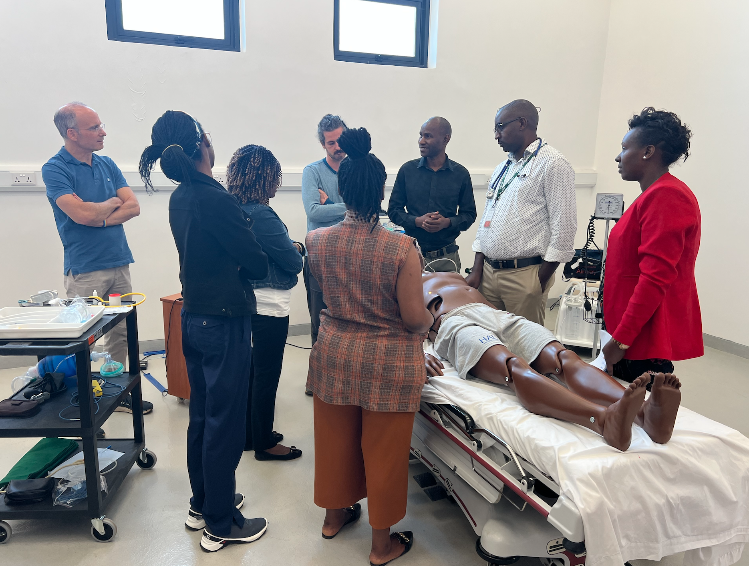
Quality Assurance for Simulation-Based Medical Education in a remote setting in Rwanda.
Ornella Masimbi, MD, MSc^{1,2} , Natnael Shimelash, MD, MSc^{1,2}, Olivia Clarke, MSc^{1,3}, Tomlin Paul, MBBS, MPH, DFPHM, FAcadMEd^{1,3}
¹University of Global Health Equity (UGHE), ² Simulation and Skills Center at UGHE, ³ Educational Development and Quality Center at UGHE.
Background
The University of Global Health Equity (UGHE) was created in 2015 in response to the stark disparities in global health.
UGHE's undergraduate medical program includes a MBBS/MGHD dual degree program, training physicians as change agents to provide more equitable, high-quality health services for all.
Simulation-based medical education (SBME) is underrepresented in Sub-Saharan Africa due to the expensive nature associated with the installation of a modern simulation center.
UGHE, despite its remote location, has invested in a state-of-the art simulation center, and up-to-date and evidence-based training of its teaching personnel.
Results
Curriculum design | Faculty development | Infrastructure and equipment | Curriculum evaluation | Partnership
7 simulation curricula designed: BMS Surgery* Obstretrics & Gynaecology* Internal Medicine* Pediatrics* Anesthesia Otolaryngology | 5 Simulation Instructor courses conducted: > 23 UGHE faculty trained 8 faculty from partner institutions trained | Simulation infrastucture: 2 exam rooms 2 large multipurpose rooms 4 control rooms 2 debrief rooms 1 store | Simulation session: Pre/post simulation session survey Checklist End of module evaluation (Student feedback) | Immersive Design Systems – BCH California University of Science and Medicne Harvard Medical School University of Minessota Stanford Medicine
> 23 high fidelity simulations developped > 40 skills sessions developped > 150 sim sessions completed 107 MBBS students reached | 1 Observership program at Immersive Design Systems/BCH: 2 UGHE faculty completed the program (2019) | Sim technologies/equipment: 4 high fidelity manikins 1 anatomage table > 10 task trainers 2 mechanical ventilators 1 Anesthesia machine > 40 anatomy models Various consumable and non-consumable medical equipment Various audio-visual equipment | Curriulum: Annual BMS SIM curriculum review Quarterly/Semiannual clinical SIM curriculum review | University of Rwanda Partners In Health Butaro District Hospital Kirehe District Hospital
Goals/Objectives for SBME
Design and implement a simulation program that provide trainees with a safe learning space to practice hands-on clinical skills, non-technical skills, and decision-making processes in order to reduce morbidity and mortality from medical errors and poor decision making.
Integrate SBME into UGHE’s core Basic Medical Sciences (BMS) and clinical curricula to facilitate early student immersion in clinical practice environments.
Promote universally high-quality medical education by serving as a hub for SBME and innovative research in the region that allows trainees, faculty, and local institutions to explore cutting-edge simulation technologies and pedagogical methods.
Improve patient safety and care in the region by providing quality medical education through a SBME program that adheres to the standards of best practices in simulation.
Table 1. Summary of Achievements in Quality Assurance for Simulation-Based Medical Education at the University of Global Health Equity, Rwanda
SIMZones
Quality Assurance Strategies
UGHE provides quality assurance for its simulation program through several strategies:
1. Simulation curriculum design:
Needs Assessment: The design process stems from each teaching department's competency requirements and entrusted professional activities, which are in turn a result of country-wide assessment survey involving health professional, educators and hospital records to identify case prevalence.
Evidence-based design: Once specific cases are identified, simulation activities are built, tested and approved by a specialized panel of simulation, BMS and clinical experts. These activities are rooted in the SimZones architecture, a framework matches simulation design and implementation approaches to specific learning needs
External validation: UGHE partners with renowned simulation centers to ensure the simulation curriculum meets international standards for quality and effectiveness in medical education.
2. Faculty and staff development: UGHE offers Continuing Professional Development (CPD) courses and observership programs at partners international simulation centers to equip staff members with up-to-date knowledge and skills in SBME.
3. Use state-of-the-art simulation equipment and infrastructure: UGHE has invested in high fidelity simulators, task trainers, audiovisual equipment and facilities to ensure adequacy and diversity of the learning environment.
4. Regular curriculum evaluation: SBME benefits from the overall curriculum review and student evaluation of teaching processes at UGHE.
Figure 1. SIMZones architecture as described by Roussin & Weinstock. Zones range from 0-4 and are determined based on type of scenario, desired content, involvement of instructor and target learning objectives.
Conclusions/Next Steps
Despite the remote location, SBME at UGHE has benefitted from strong leadership, academic partnerships, and a clear vision for continuous quality improvement.
The UGHE's comprehensive approach to implementing Quality Assurance for SBME is a foundation for improving outcomes in health professions' education and patient care.
This approach provides a framework for similar programs in remote settings around the world.
UGHE aims to enhance its educational efficacy for SBME, through infrastructural improvements, faculty development, strategic partnerships, and ongoing curriculum renewal and refinement.
A
B
References
Roussin CJ, Weinstock P. SimZones: An Organizational Innovation for Simulation Programs and Centers. Acad Med. Aug 2017;92(8):1114-1120.
PROGRAMME SPECIFICATION FORM University of Global Health Equity MBBS/MGHD Integrated Degree Program December 2021
Alayande B, Iradakunda J, Forbes C, Hey MT, Majyambere JP, Powel B, Perl J, Ntirenganya F, McCall N, Paul T, Anderson GA, Riviello R, Bekele A (2023) Results of a Modified Delphi Process in Developing a Surgical Undergraduate Medical Curriculum in Rwanda. The College of Surgeons of East Central and Southern Africa (COSECSA) 22nd Conference, Dec 2022.
C
Figure 2. A) UGHE Butaro Campus, B) Dr. Masimbi using the Anatomage table, a virtual dissection tool, to teach anatomy to MBBS students, C) Faculty practice Zone 2 facilitation methods during sim instructor course led by Dr. Peter Weinstock.

