Slide 1
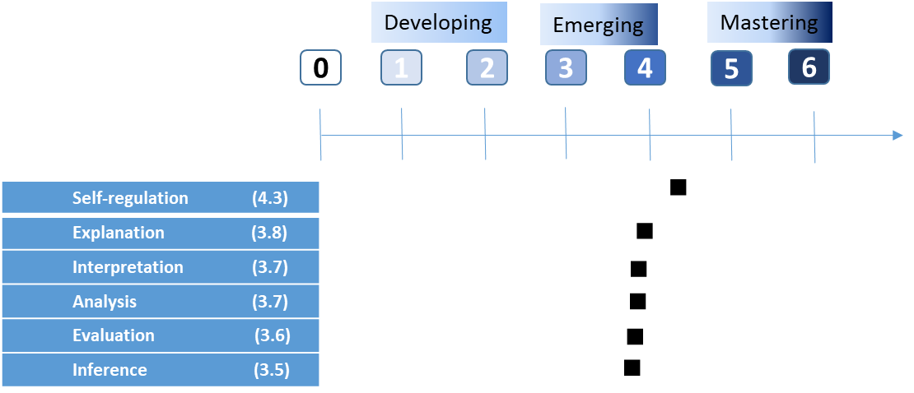
Measuring Students’ Critical Thinking Mindset and Reasoning Skills at an American-style University
Hayfa Jafar, Munirah Akber Ahmed & Tobin Hartnell
American University of Iraq, Sulaimani
Introduction
Research Methods
Results
Conclusion
The development and enhancement of undergraduate students' critical thinking (CT) skills are key objectives of higher education institutions, particularly within liberal arts universities. However, assessing the development of students' CT skills has been challenging for institutions as well as faculty due to multiple systemic, contextual, and individual factors (Yuan and Stapleton, 2020). This study focuses on an American-style university that utilizes a pedagogical or curricular approach that promotes liberal thinking. This approach differs significantly from the education systems in secondary schools in the region, where the emphasis is primarily on rote learning, memorization, and exam preparation. While memorization has many valuable uses, it does not foster CT skills (Facione, 2020). Some studies have raised concerns about the weak quality assurance regimes used in these institutions, particularly regarding the quality of learning and pedagogical approaches (Jaschik, 2015; Long, 2018), as students there fail to develop CT skills to satisfactory standards (Rostron, 2009). Therefore, it is necessary to conduct more empirical research into CT while considering various educational contexts and adopting a comprehensive view by examining students' and faculties' perspectives during the learning and assessment processes.
This ongoing study examines the effects of the undergraduate experience at AUIS using a mixed methods research design that comprises three components.
Achievement of Related Course Learning Outcomes
The analysis offers empirical evidence regarding the development of critical thinking skills at the American University of Iraq, Sulaimani. This development is attributed to the pedagogical approaches employed by many faculty members, such as utilizing questioning techniques, evaluating arguments and resources, and fostering critical writing skills.
The data shows that the development of critical thinking (CT) skills, specifically, analyzing arguments and locating, analyzing, and using information, is strongly associated with the quality of learning and instruction. Nevertheless, proof of effective instructions is needed to validate this association.
Data from the course evaluation shows that critical thinking (CT) skills are more prominently demonstrated among students in the humanities compared to those in STEM majors. However, the scores from the CT rubrics do not show a significant difference in the development of CT skills by majors. This is mostly attributed to the small sample size. Overall, the majority of students demonstrated an emerging level of critical thinking skills.
Students who directly enrolled in undergraduate programs demonstrated an emerging level of critical thinking skills, while students who started their university study in the Academic Preparatory Program (APP) showed a developing level of CT skills.
Courses within the core program (liberal arts) significantly contribute to the development of critical thinking skills.
Some students utilize social media and online resources to enhance their CT and language skills.
Barriers to developing advanced critical thinking skills
The lack of a unified approach toward promoting and teaching CT poses a barrier to cultivating advanced levels of these skills.
Communication in English presents a barrier to building CT skills.
Many students resist active engagement in their learning due to various contextual, structural, and personal reasons.
Several faculty members resist promoting critical thinking and rely on traditional teaching methods due to a lack of teaching skills regarding critical thinking, the influence of institutional culture, and students' educational backgrounds and motivation towards learning.
Students' perception about CT and the quality of instructions
Disciplinee independent quetions to measure CT attributes
Achievemnt of CLOs in 86 courses
Variable | # of courses | # of students | Mean | Std. Dev. | Min | Max
Evaluate Argument | 86 | 1,670 | 69% | 18% | 17% | 100%
Locate Information | 86 | 1,670 | 75% | 16% | 23% | 100%
(1) Semi-structured interviews were conducted with 18 students to gather their reflections on their learning experiences, perceptions of how instructors emphasize critical thinking (CT) skills, and feedback on faculty teaching and assessment practices. Below is the profile of the sample:
Participants’ profile |  | N=18
Gender | Female Male | 56% 44%
Majors | Humanities STEM | 67% 33%
Education Level | Freshmen Semaphores Juniors Seniors | 28% 11% 33% 28%
Entry Level | Academic Preparatory Program (APP) Undergraduate (UG) | 33% 67%
High School Type | Private Public | 56% 44%
Objectives
Average CT score by attributes
The study offers empirical evidence on measuring the achievement of learning outcomes associated with the development of critical thinking (CT) and reasoning skills.
The objective of this study is to provide a thorough understanding of how to assess CT and incorporate this assessment into the institutional quality assurance system by means of program and course review processes.
(2) Participants responded to discipline-independent questions that assessed various critical thinking attributes, including self-regulation, explanation, interpretation, analysis, evaluation, and inference. A scoring rubric was utilized to measure the development of CT skills.
Average CT score by different student statuses
Research Question
 |  | Academic Discipline |  | Entry Level |  | High School Type
Critical Thinking Attributes | Grand Total | STEM | Humanities | UG | APP | Private | Public
Overall score | 3.8 | 3.9 | 3.7 | 4.6 | 2.1 | 3.9 | 3.7
Self-regulation | 4.3 | 4.2 | 4.5 | 5.2 | 2.5 | 4.4 | 4.1
Explanation | 3.8 | 4.0 | 3.8 | 4.5 | 2.5 | 4.0 | 3.6
Interpretation | 3.7 | 3.8 | 3.7 | 4.6 | 2.0 | 4.0 | 3.4
Analysis | 3.7 | 3.7 | 3.8 | 4.6 | 2.0 | 3.7 | 3.8
Evaluation | 3.6 | 3.8 | 3.8 | 4.3 | 2.0 | 3.6 | 3.5
Inference | 3.5 | 3.7 | 3.4 | 4.3 | 1.8 | 3.5 | 3.5
This study focuses on students' development of and dispositions toward critical thinking and reasoning skills at an American-style university. Its objective is to address the research question:
How do the instructional strategies implemented at the university as a whole affect students' development of and disposition toward critical thinking and reasoning skills?
Source: Center for Teaching, Learning, & Technology at Washington State University (2006)
(3) Data from the Fall 2019 Course Evaluation Survey was used to measure The achievement of course learning outcomes the are specifically related to critical thinking skills (evaluating arguments and locating, evaluating, and using information).
References
Facione, P. A (2020). Critical Thinking What it Is and Why It Counts. Insight Assessment. https://www.insightassessment.com/wp-content/uploads/ia/pdf/whatwhy.pdf
Jaschik, S. (2015, May 11). Is newest ‘American U. of…’ really American? Inside Higher Ed. Retrieved from https://www.insidehighered.com/news/2015/05/11/questions-raisedabout-whether-american-u-malta-really-american.
Rostron, M. (2009). Liberal arts education in Qatar: Intercultural perspectives. Intercultural Education, 20(3), 219–229. https://doi.org/10.1080/14675980903138517.
Yuan, R. & Stapleton, P. (2020). Student teachers’ perceptions of critical thinking and its teaching. ELT Journal. 74(1), 40-48.
Limitations & Next Steps
The sample size in this study is too small, and might not represent AUIS students' critical thinking skills across different majors and years of study.
Most of the students were selected using convenience sampling, which may introduce sampling bias. To ensure a representative sample and reliable results, additional interviews will be conducted.
The data collected on the difference between the achievements of students who attended private and public schools does not necessarily reflect how these two education systems affect students' acquisition of critical thinking skills in Kurdistan.
This study is in progress, faculty perspective will be integrated into the analysis to validate the results and provide a comprehensive understanding of the development of critical thinking at AUIS.
Due to funding issues, we were unable to purchase any validated critical thinking assessment tools, which limited our inquiry scope and assessment methods.
Contact Information
Dr. Hayfa Jafar
Hayfa.jafar@auis.edu.krd
Director Institutional Effectiveness – American University of Iraq – Sulaimani
Munirah Akber Ahmed
munirah.akber@auis.edu.krd
Adjunct Faculty, Social Sciences Department- American University of Iraq - Sulaimani

