Slide 1

Naji Almahdi

Slide 2
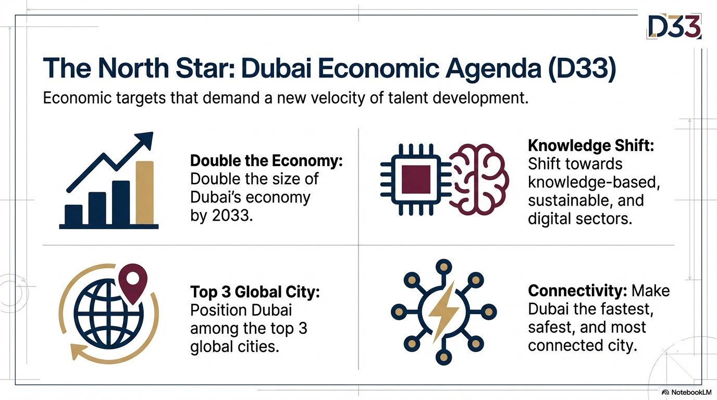
Naji Almahdi

Slide 3
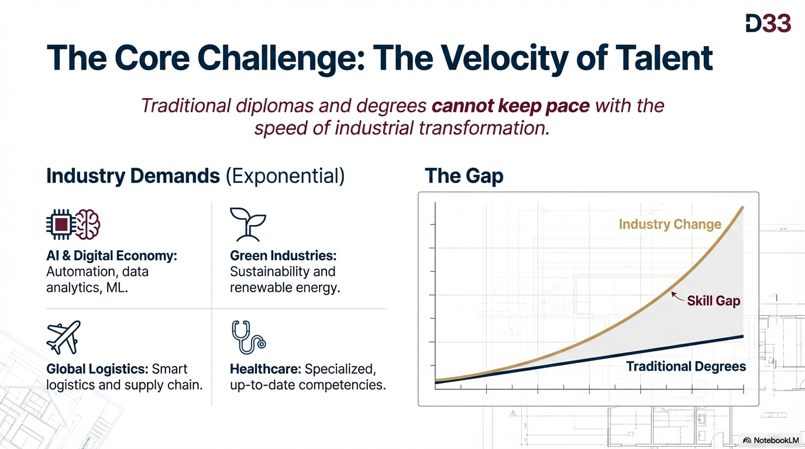
Naji Almahdi

Slide 4
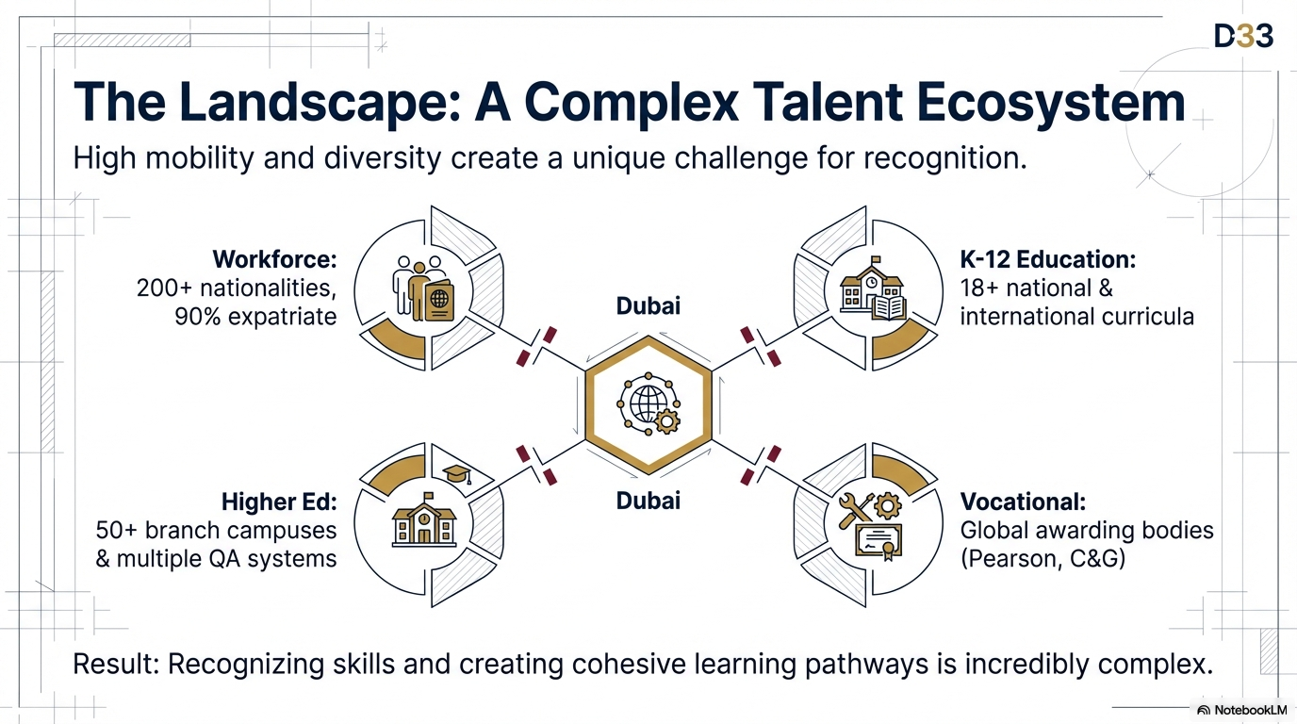
Naji Almahdi

Slide 5
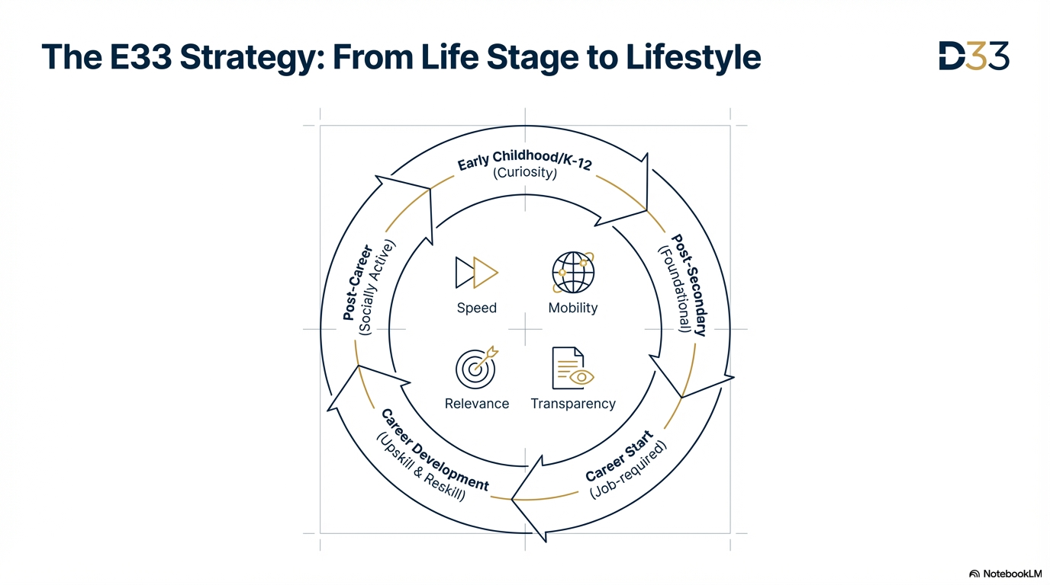
Naji Almahdi

Slide 6
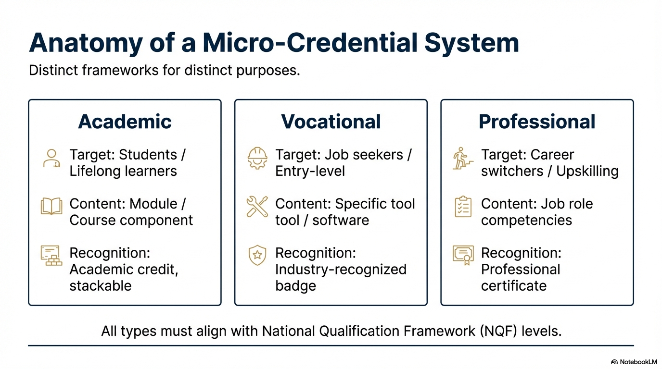
Naji Almahdi

Slide 7
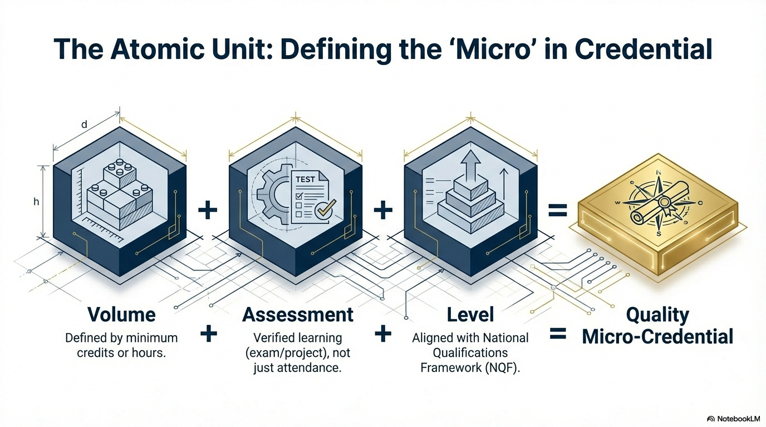
Naji Almahdi

Slide 8
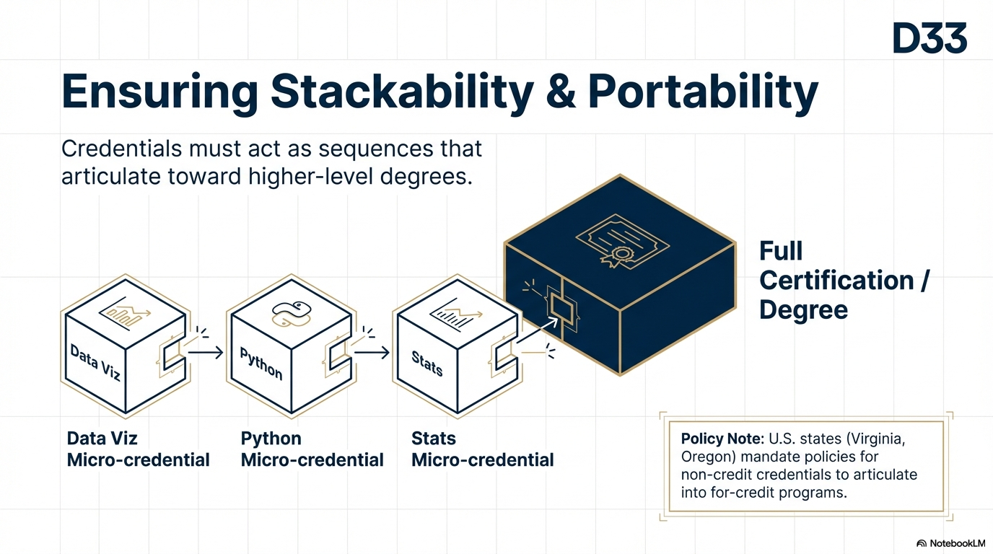
Naji Almahdi

Slide 9
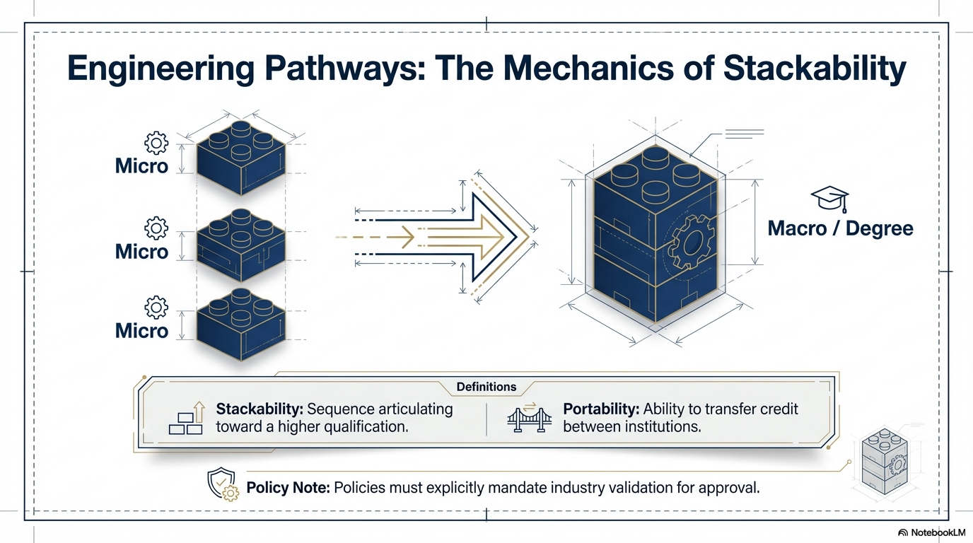
Naji Almahdi

Slide 10
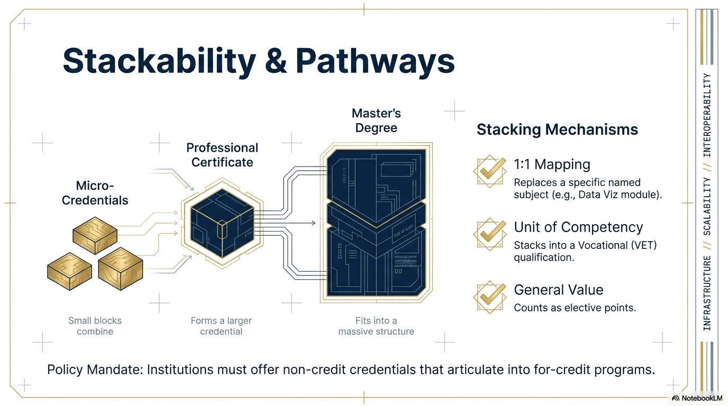
Naji Almahdi

Slide 11
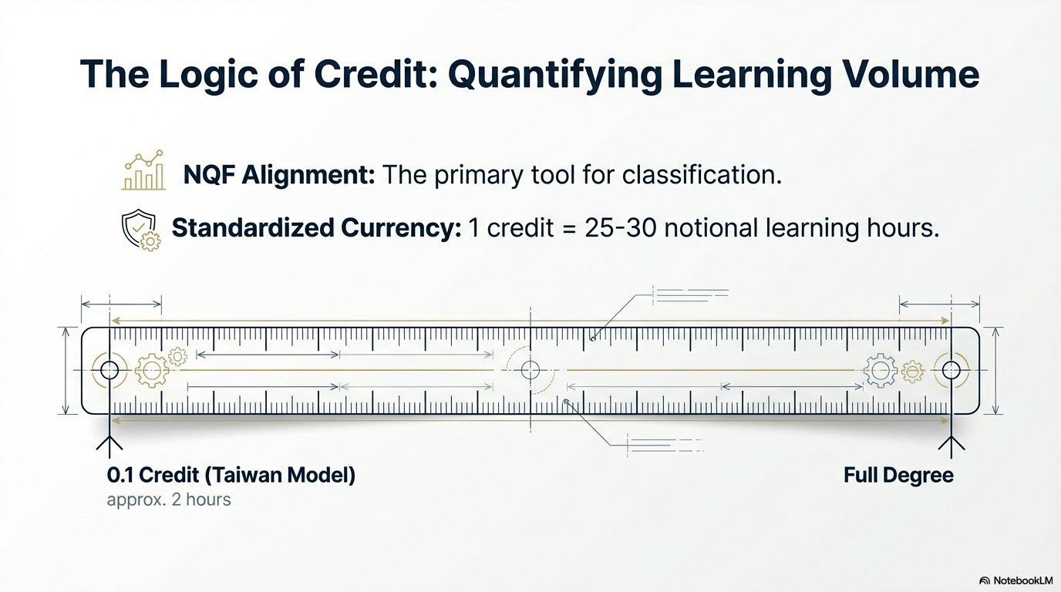
Naji Almahdi

Slide 12
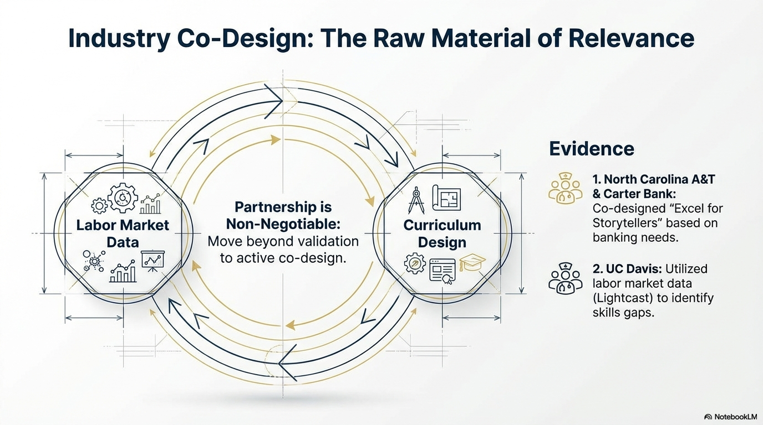
Naji Almahdi

Slide 13
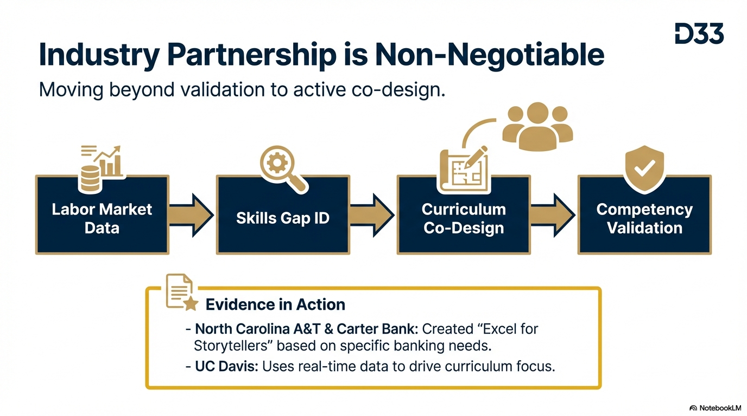
Naji Almahdi

Slide 14
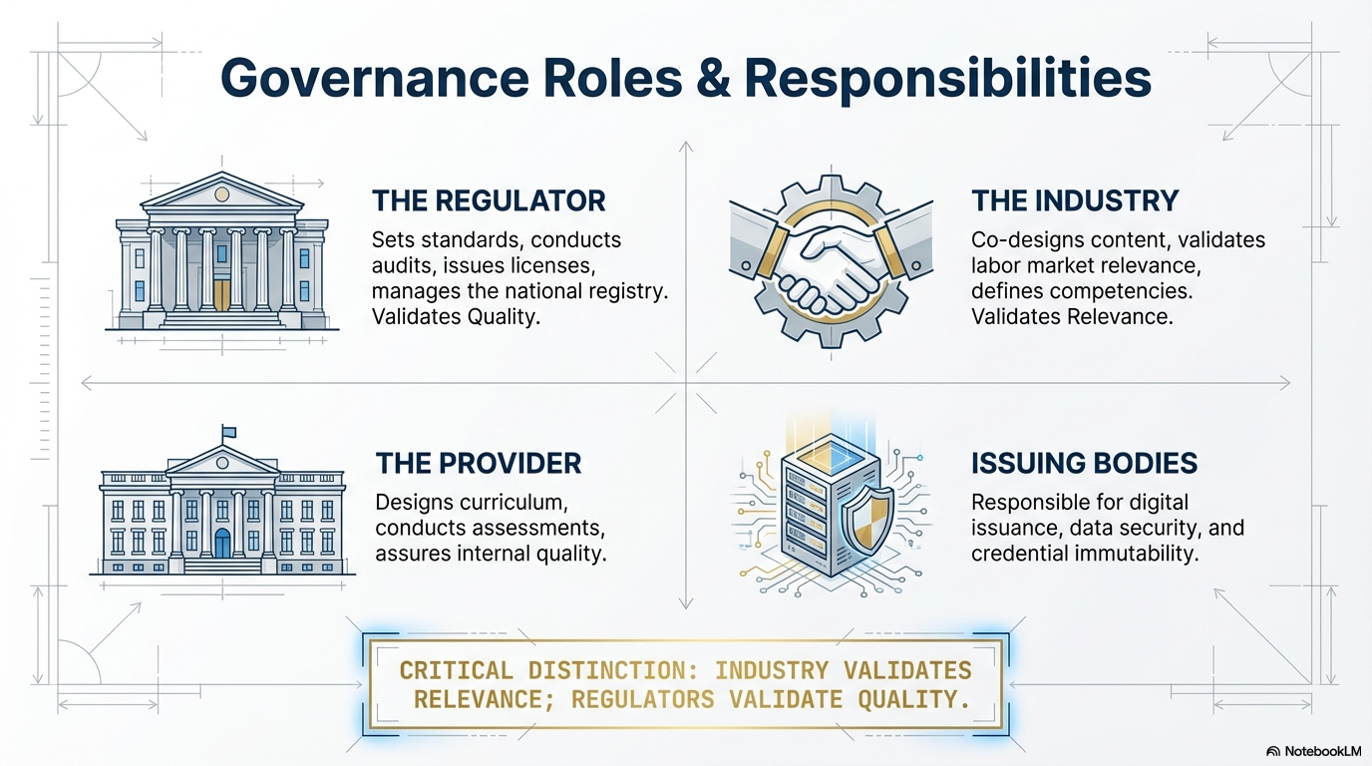
Naji Almahdi

Slide 15
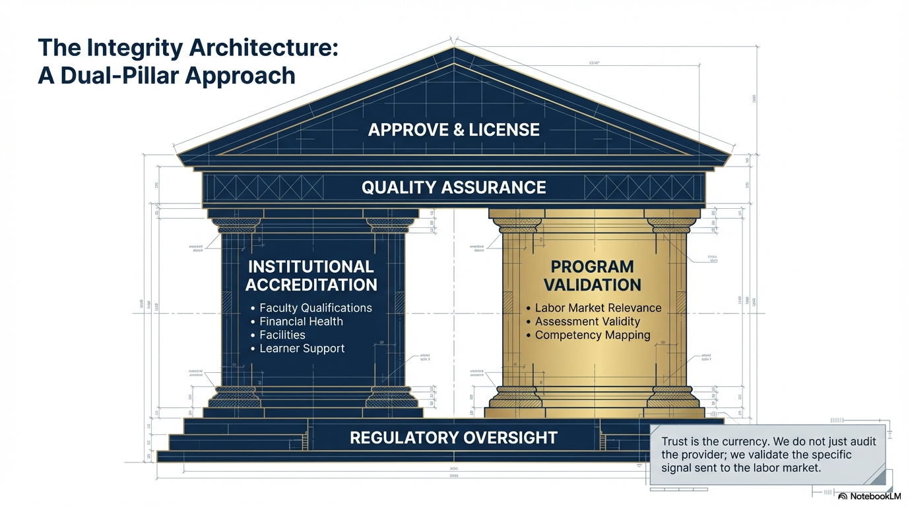
Naji Almahdi

Slide 16
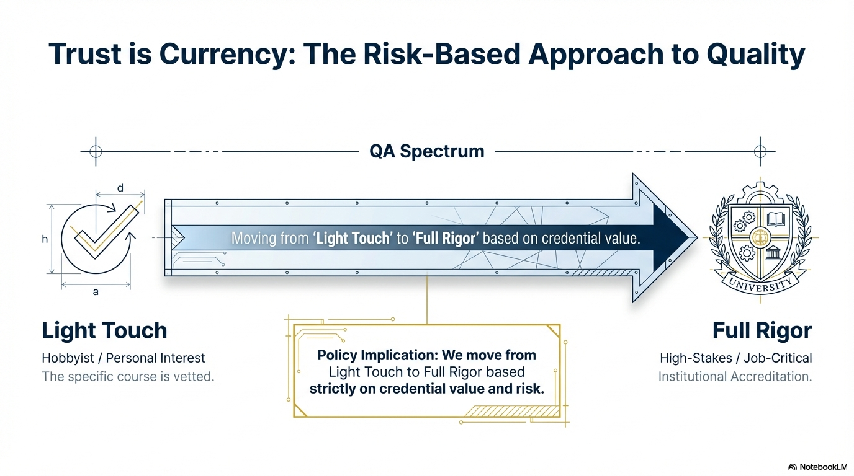
Naji Almahdi

Slide 17
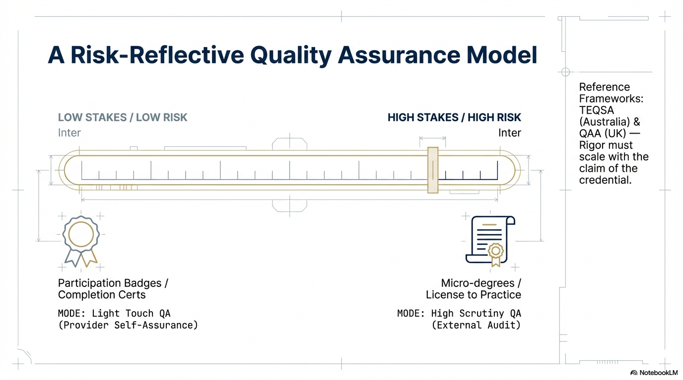
Naji Almahdi

Slide 18
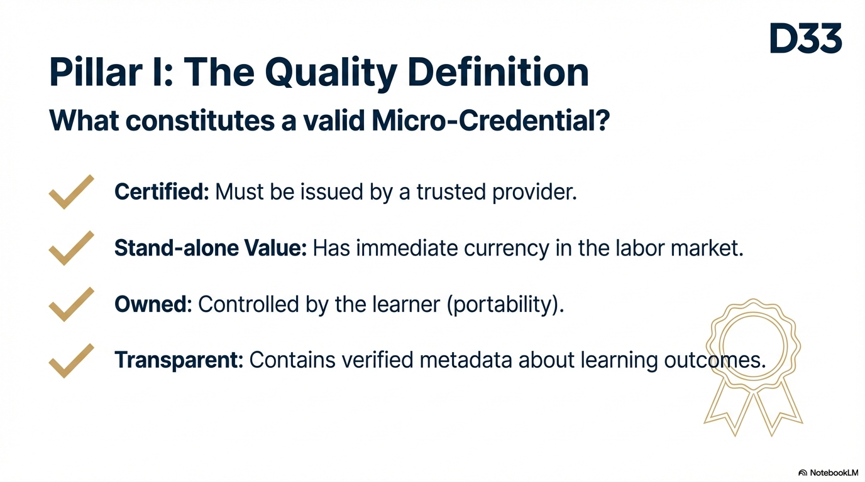
Naji Almahdi

Slide 19
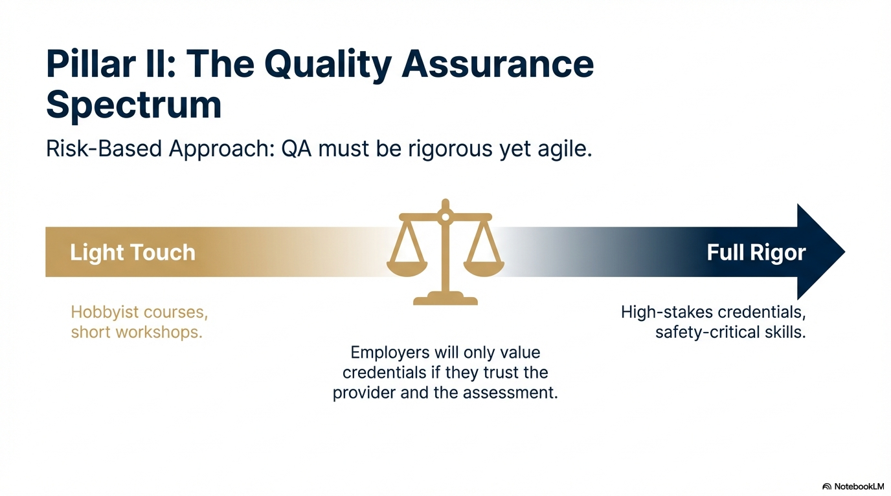
Naji Almahdi

Slide 20
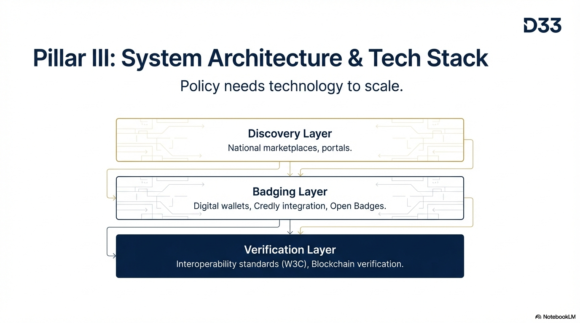
Naji Almahdi

Slide 21
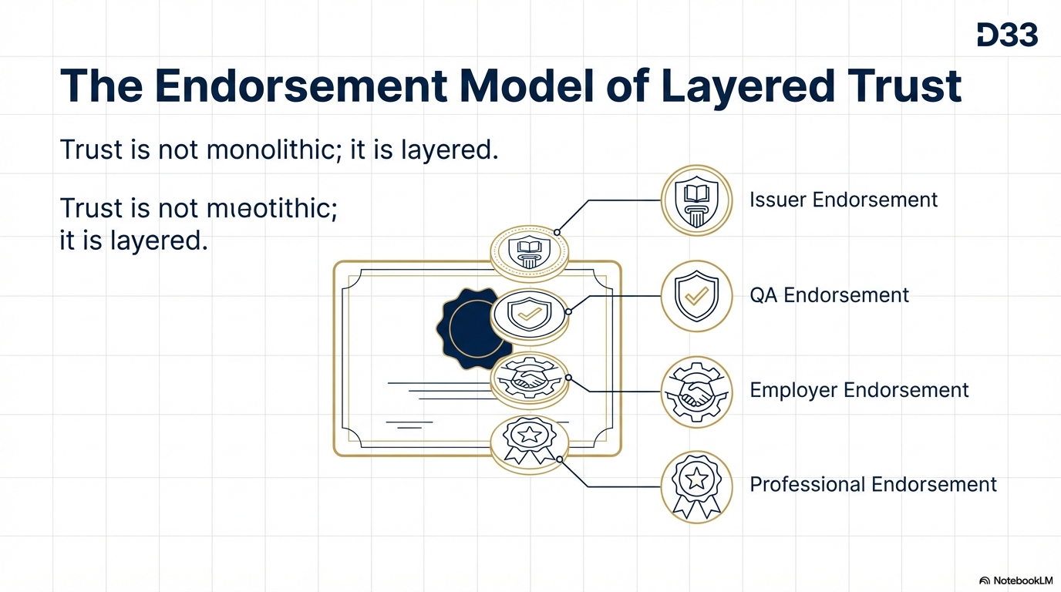
Naji Almahdi

Slide 22
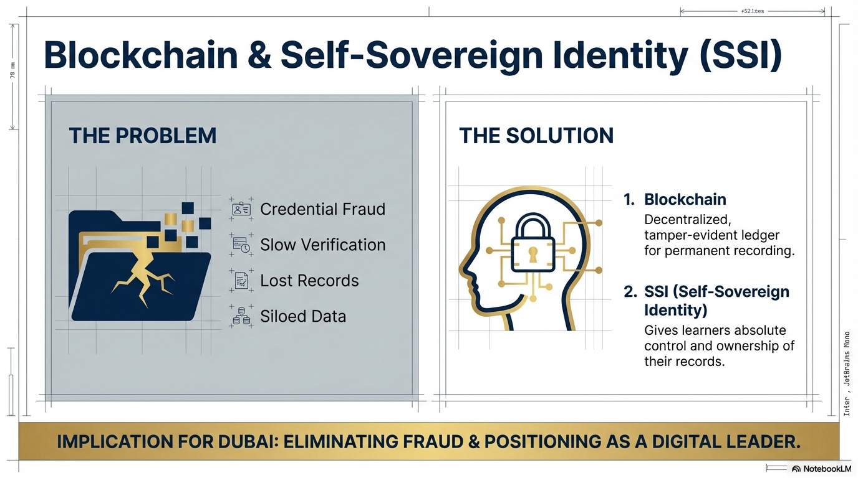
Naji Almahdi

Slide 23
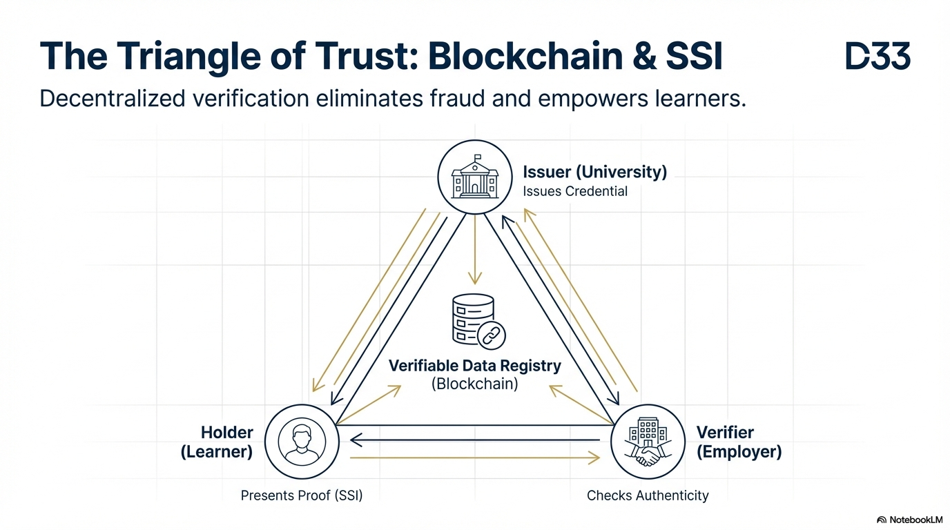
Naji Almahdi

Slide 24
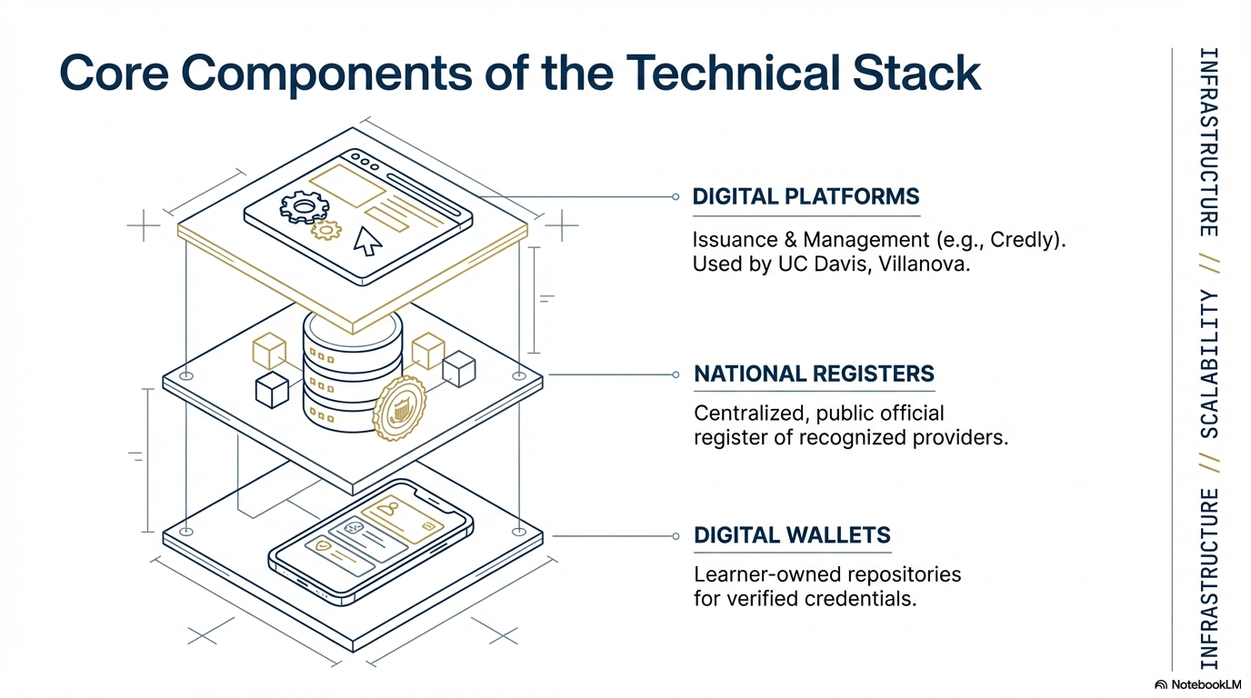
Naji Almahdi

Slide 25
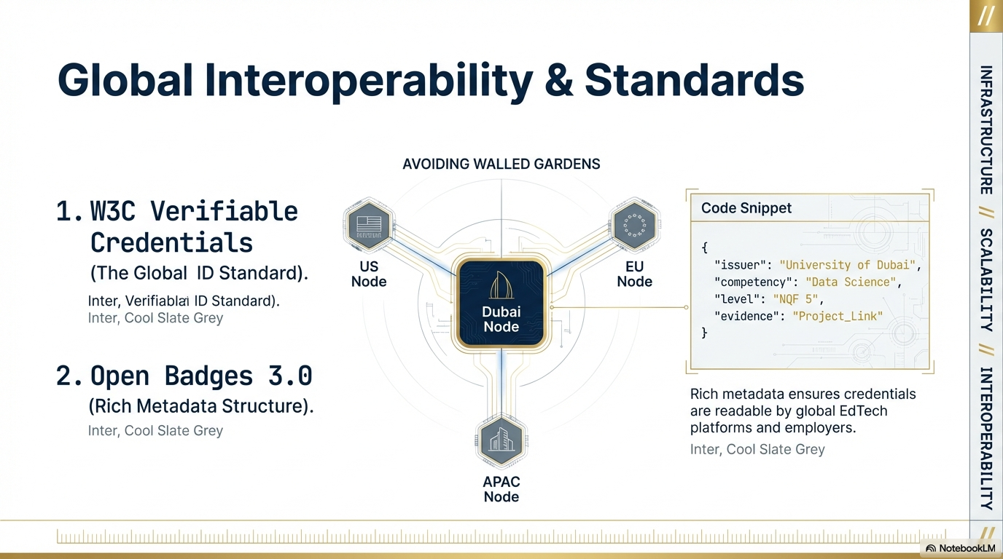
Naji Almahdi

Slide 26
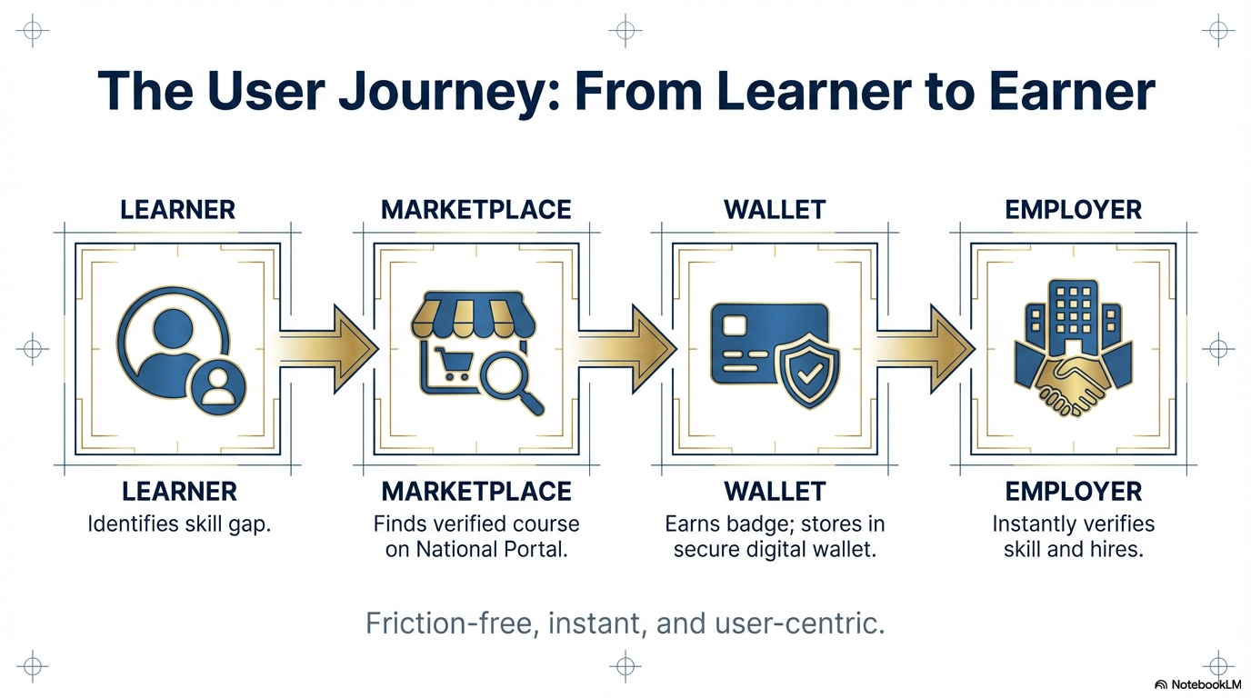
Naji Almahdi

Slide 27
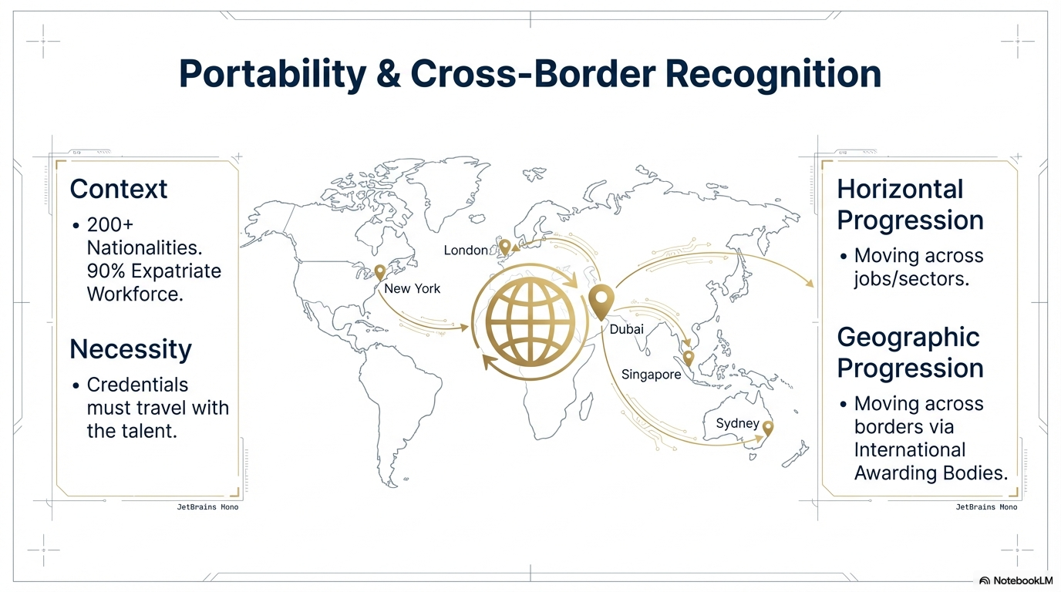
Naji Almahdi

Slide 28
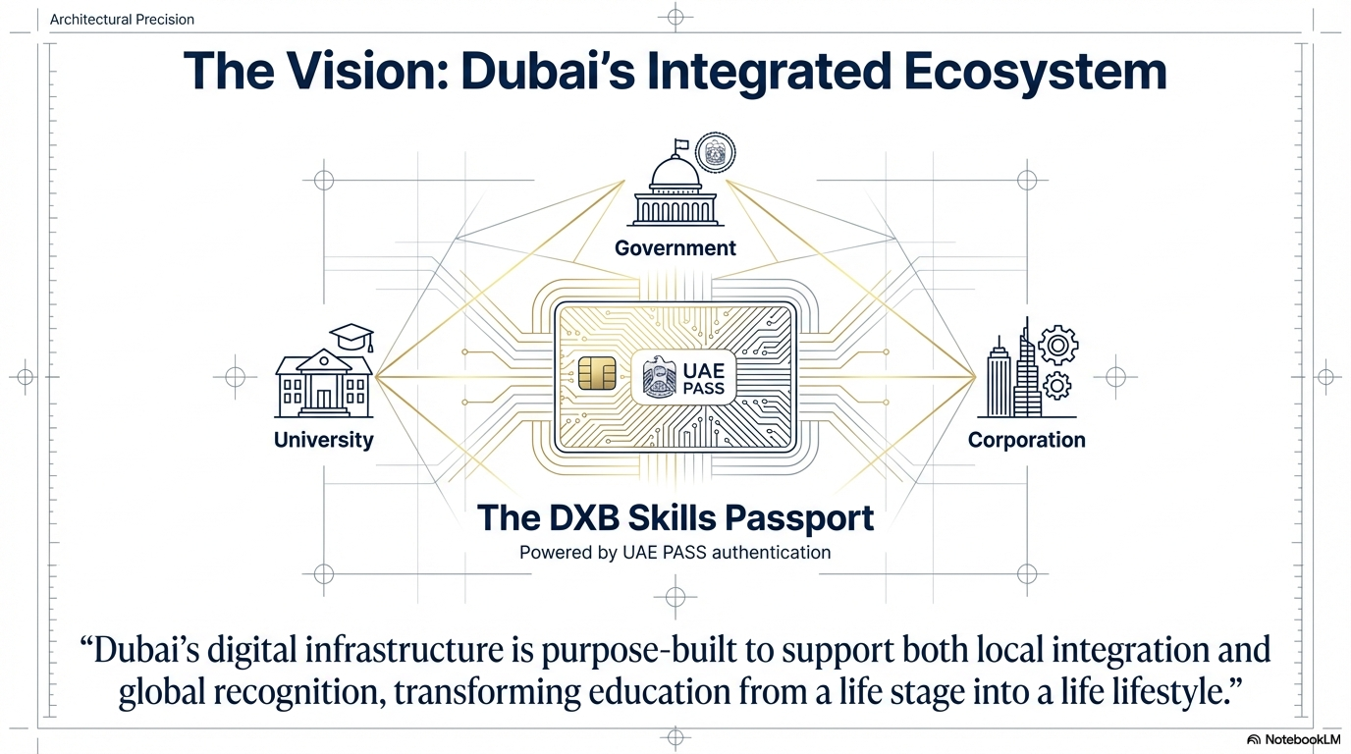
Naji Almahdi

Slide 29
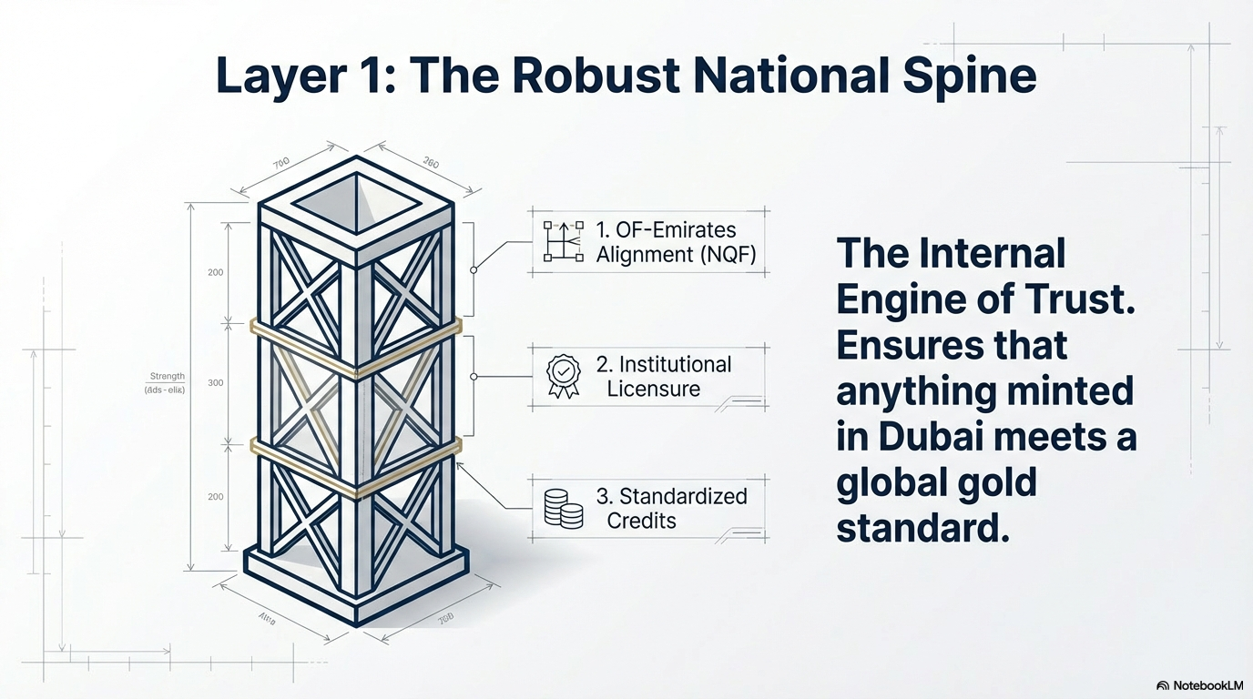
Naji Almahdi

Slide 30
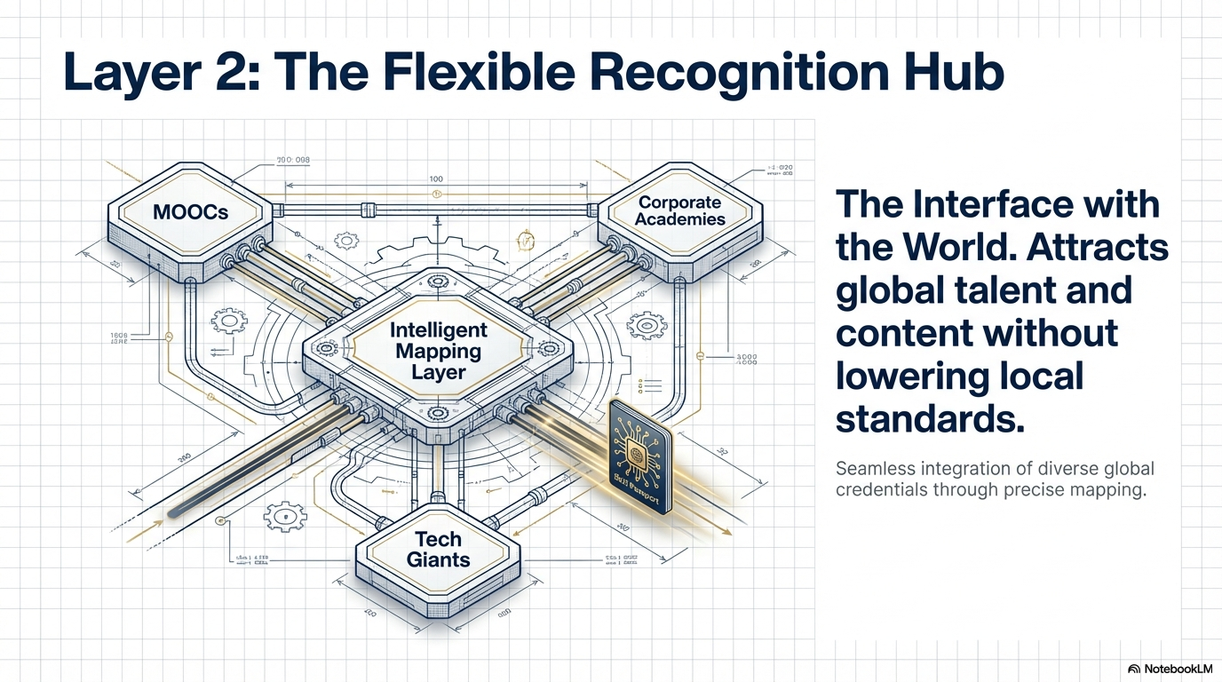
Naji Almahdi

Slide 31
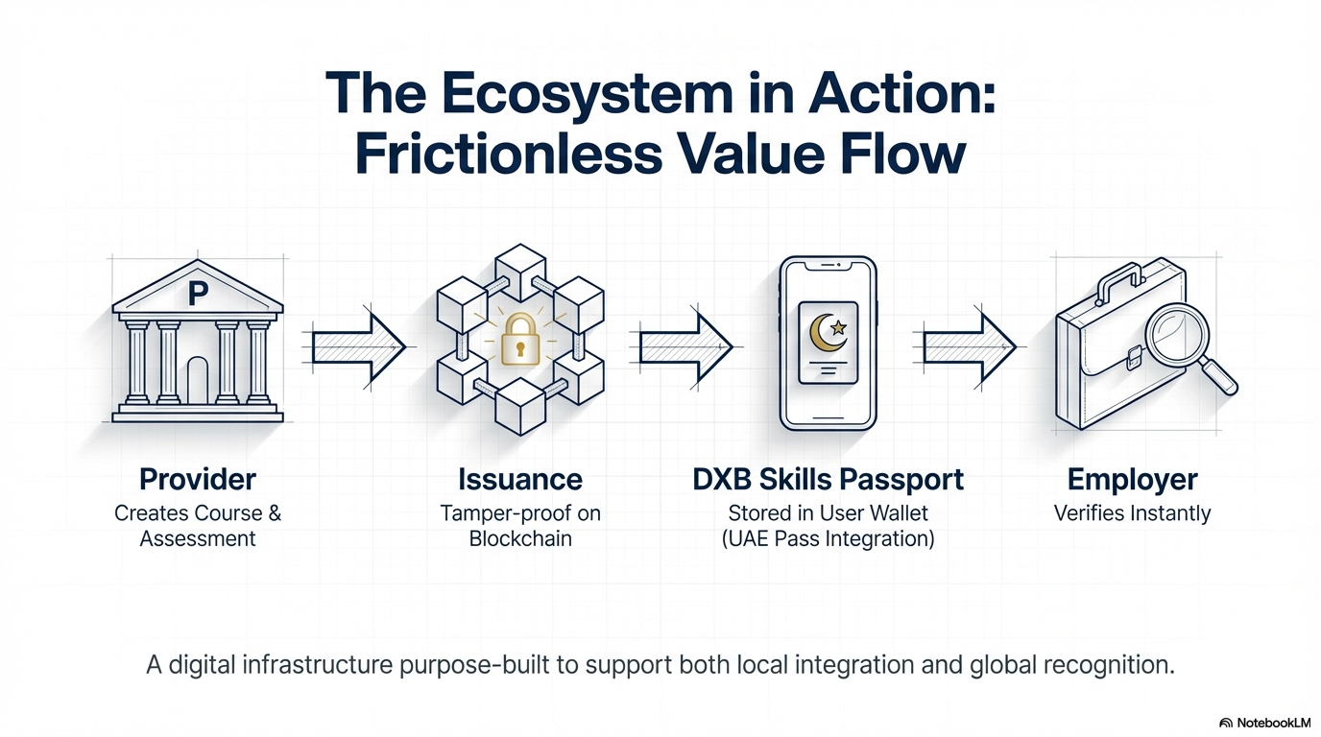
Naji Almahdi

